Slide 1
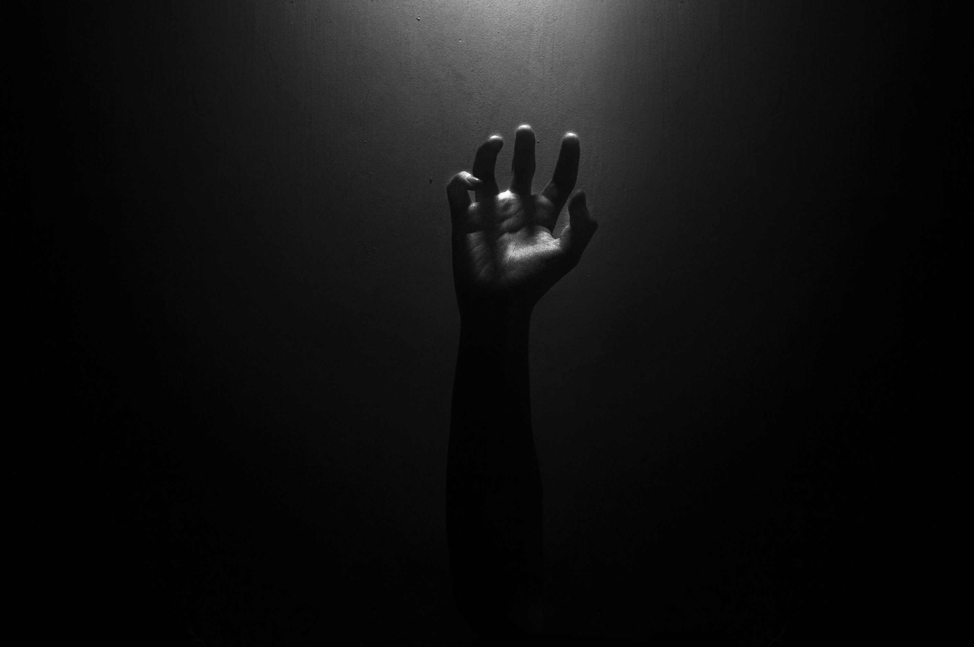
MAJor Evaluation Project
(UNREAL ENGINE VR DEVELOPMET)
Gauraang Goel
21CSU319
THE LAST VRISION:
MANKIND’S LAST HOPE

Slide 2
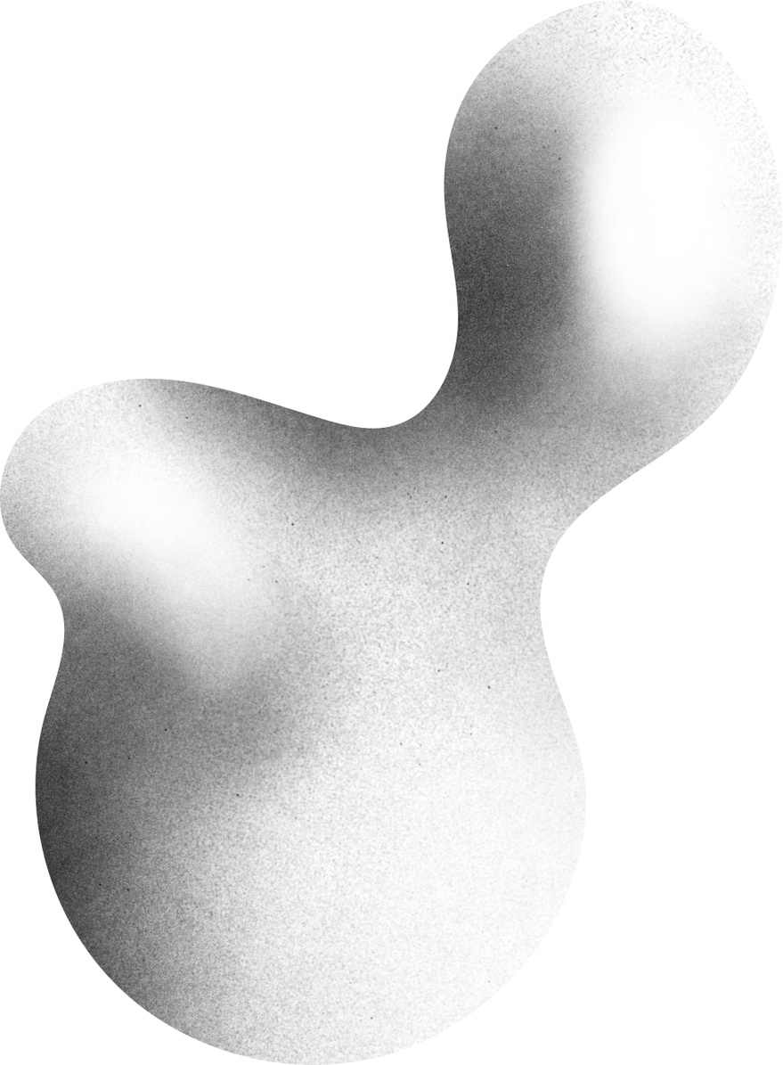

Table Of Content
01
ABOUT THE GAME
05
STATE MACHINE CHART
09
PROMBLEM FACED
02
OBJECTIVES
06
IN GAME SCREENSHOTS
03
BLUEPRINTS CREATED
07
ASSET USED
04
FEATURES
08
REFERNCES

Slide 3

Step into the chaos of a relentless apocalypse in this immersive VR zombie survival game. Fight wave after wave of the undead, scavenging for weapons to stay alive. With each wave growing more challenging, your skills and strategy will be tested to their limits. Inspired by the iconic Black Ops Zombie mode.
ABOUT THE GAME

Slide 4

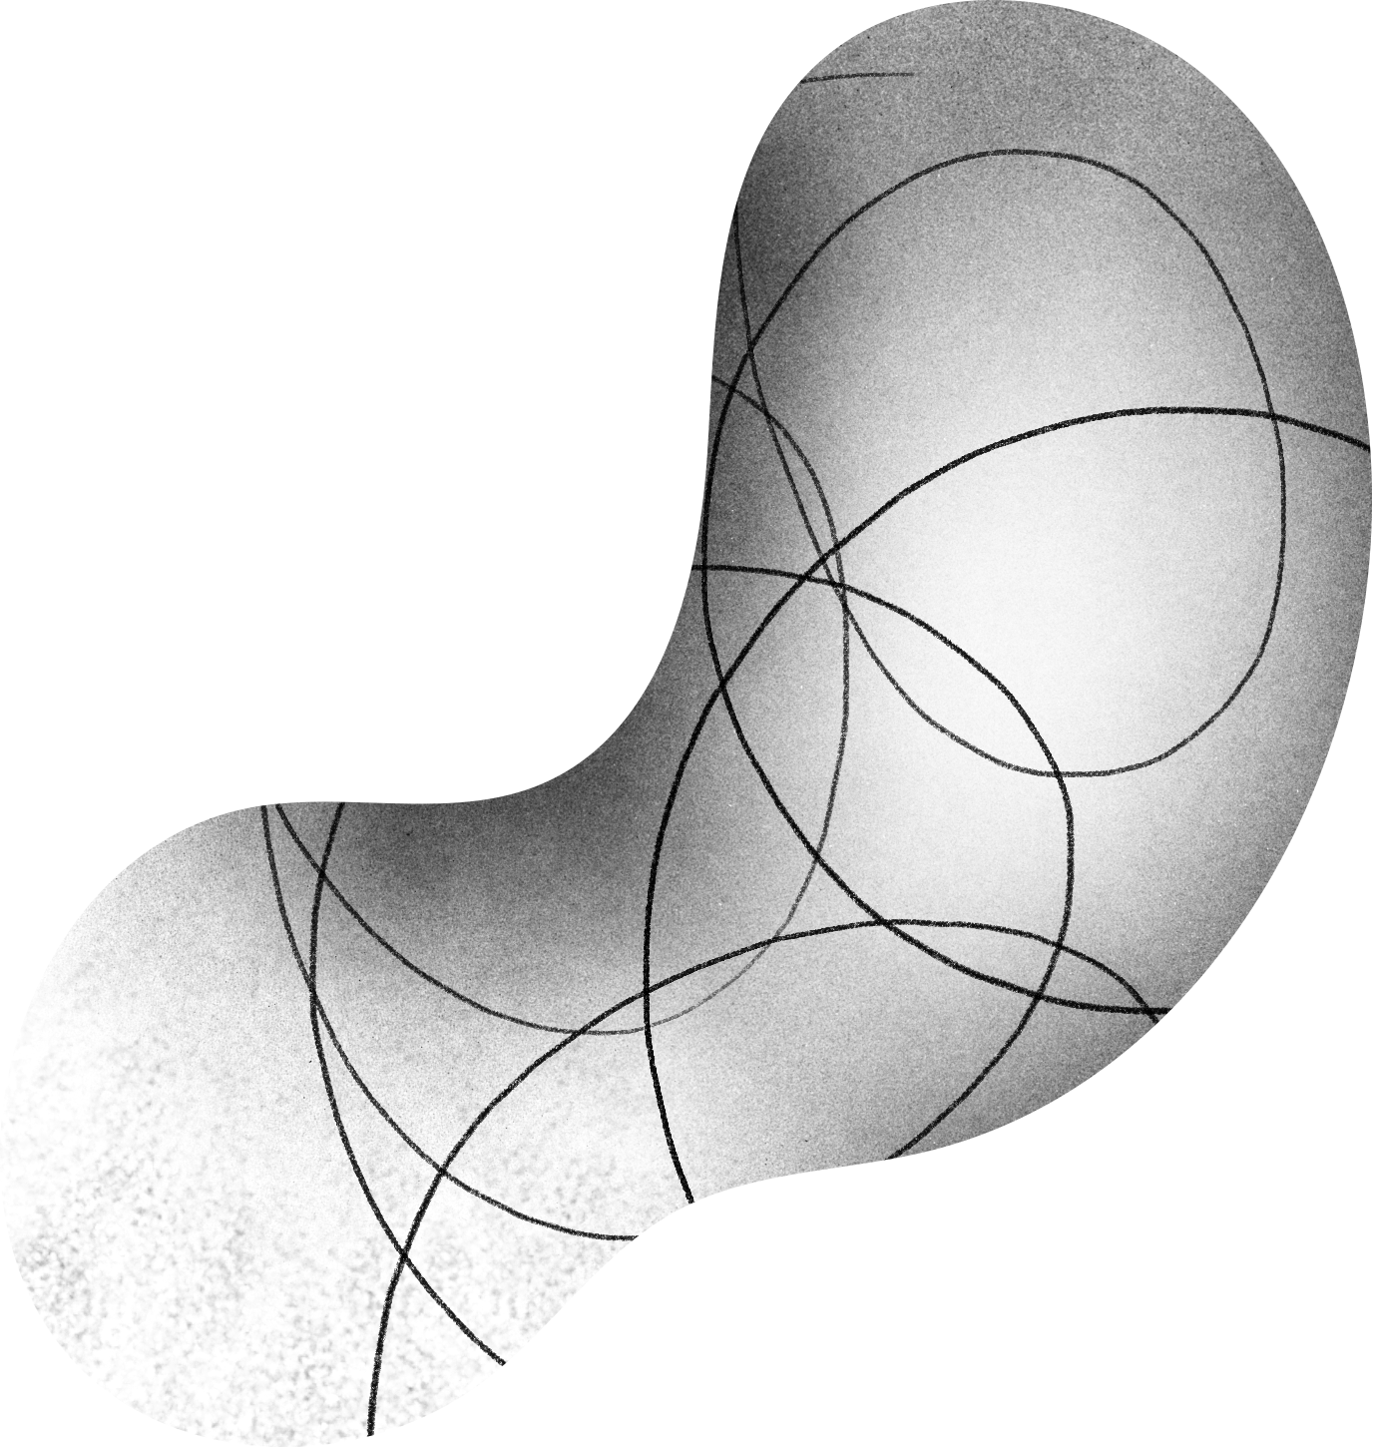
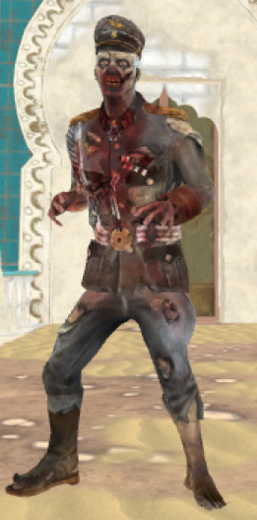
Objectives
Survive as long as possible against relentless waves of zombies. Fight, strategize, and adapt to overcome increasing challenges while upgrading weapons, and unlocking new areas. The longer you last, the greater the rewards—but remember, the undead never stop coming. Your ultimate goal: endure the apocalypse and become humanity's last beacon of hope.
MAIN OBJECTIVES:
  PLAYER MOVEMENT AND COMBAT
  ENEMY AI AND COMBAT
  WEAPON SYSTEM IMPLEMENTATION

Slide 5
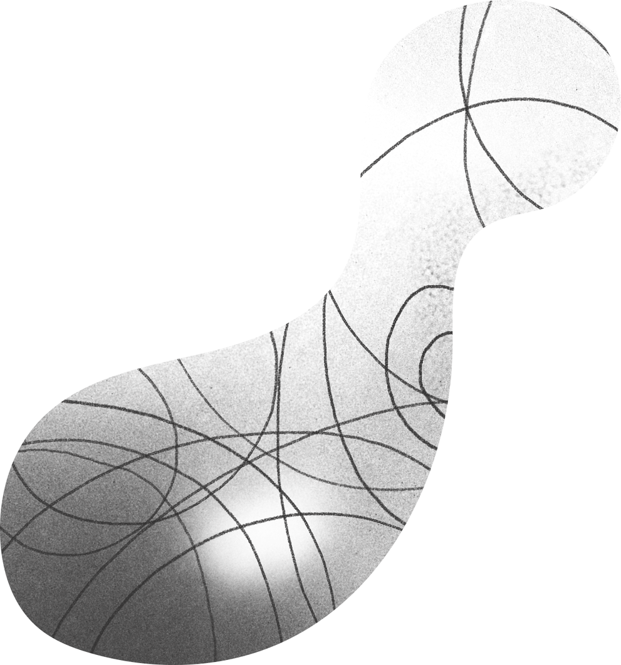

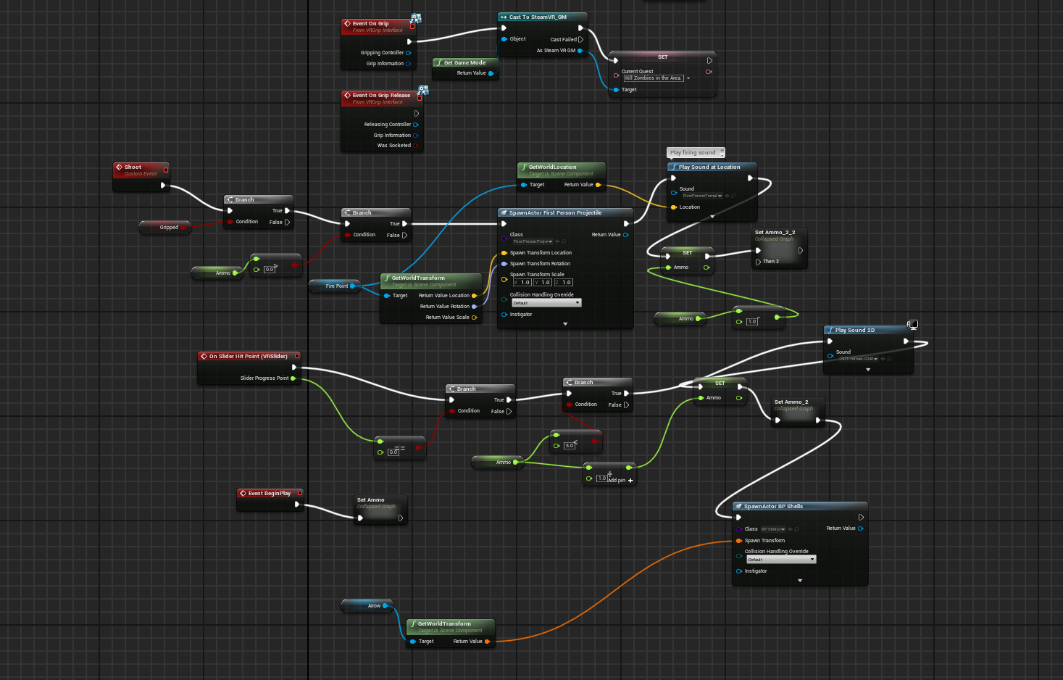
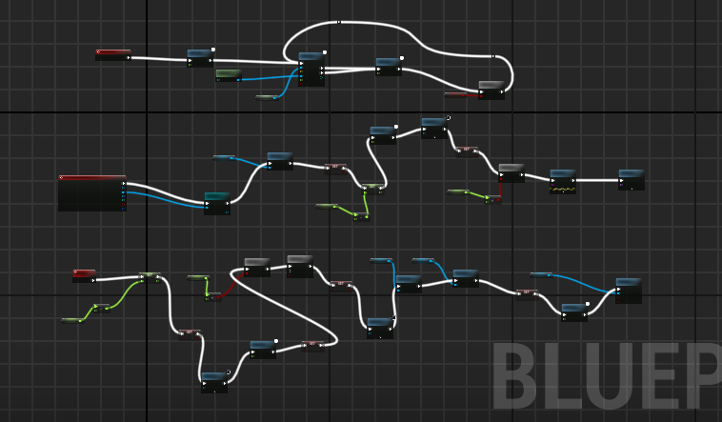

BLUEPRINTS Created

Slide 6
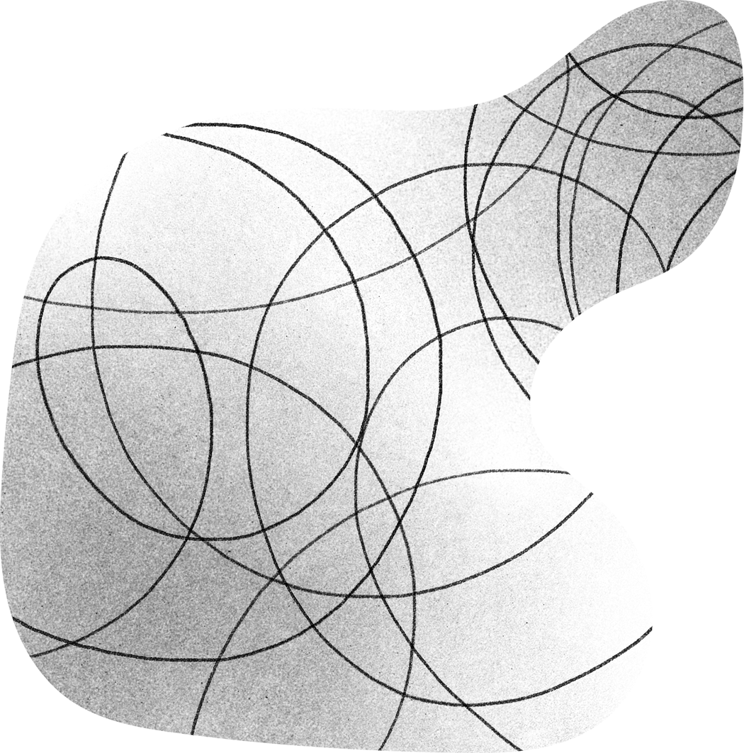
FEATURES
  Wave Spawning after a fixed interval of time.
  Player Movement and Enemies State System.
  Weapon System implementation.
  Enemy AI Implementation.
  Climbing Feature Implemented.
  Drag and drop objective box.
  Audio And Visual

Slide 7

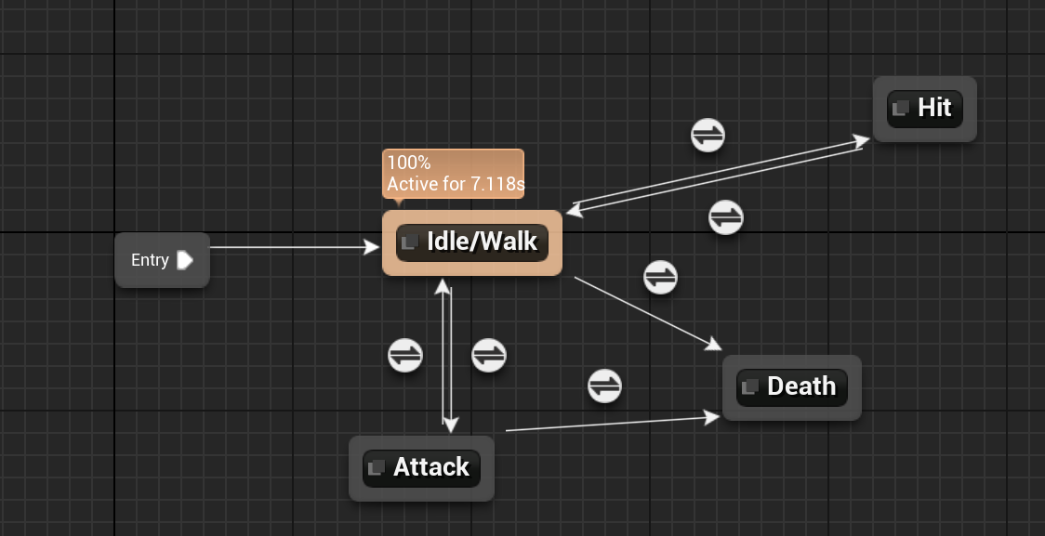
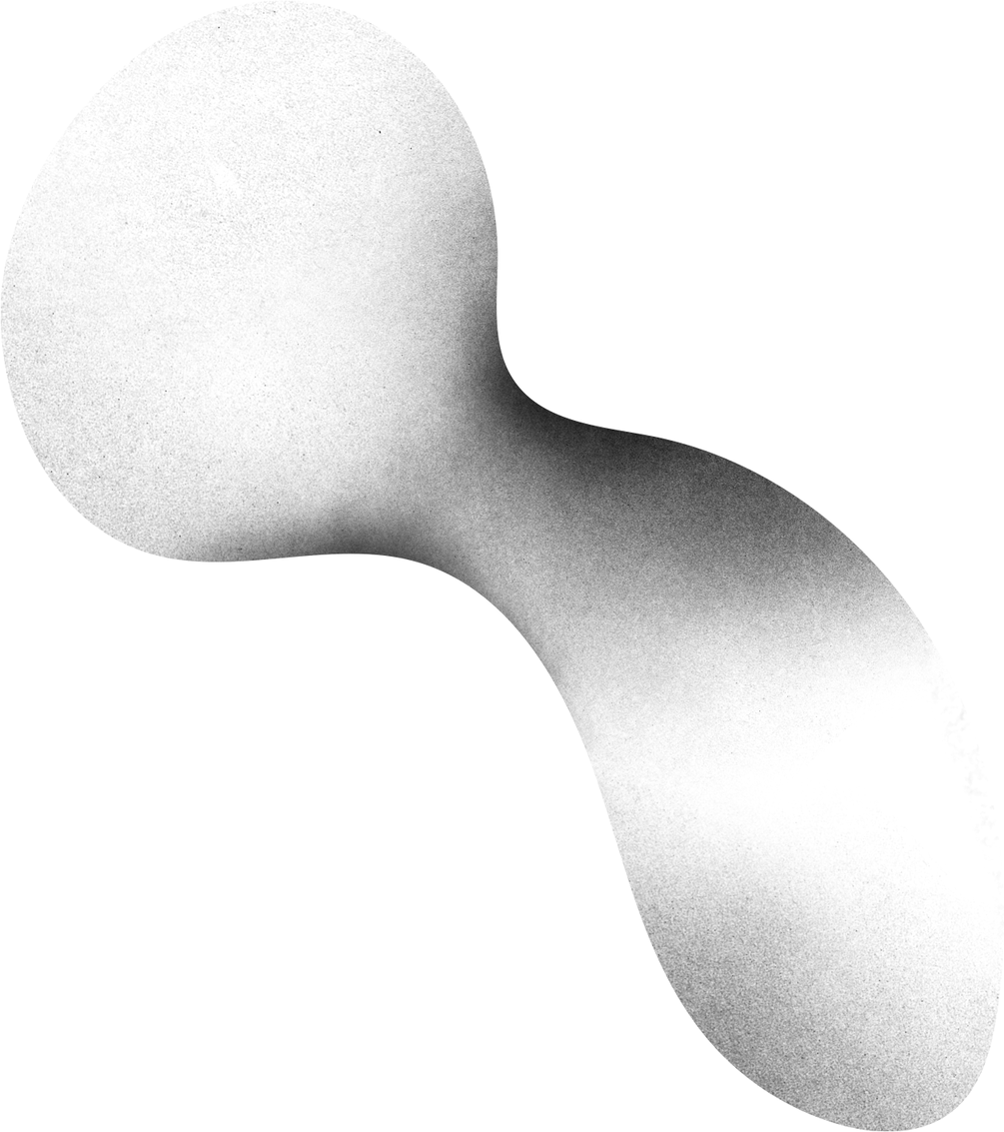
STATE MACHINE CHART

Slide 8
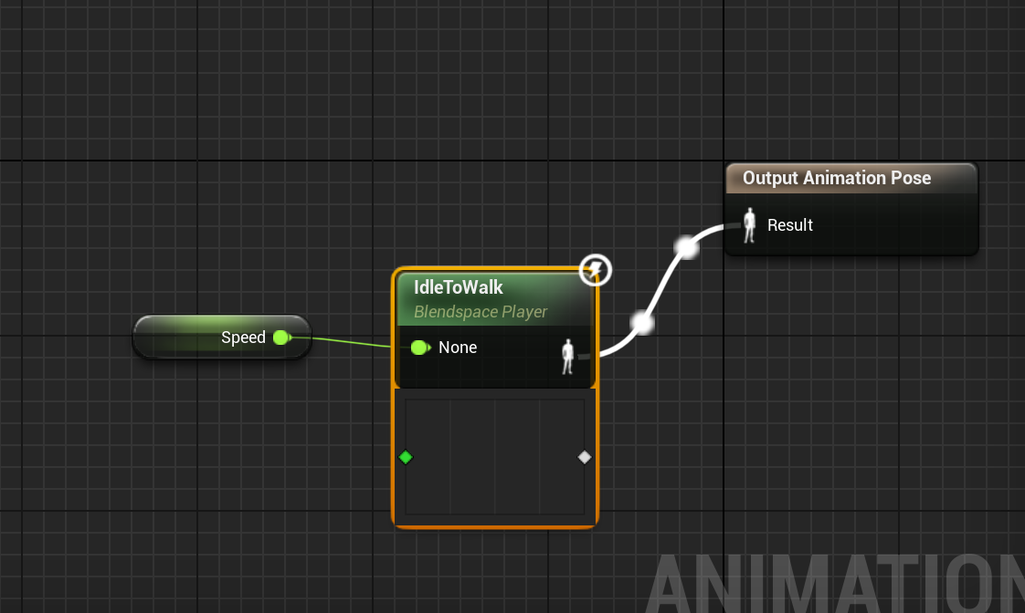
Blend ANIMATIONS

Slide 9
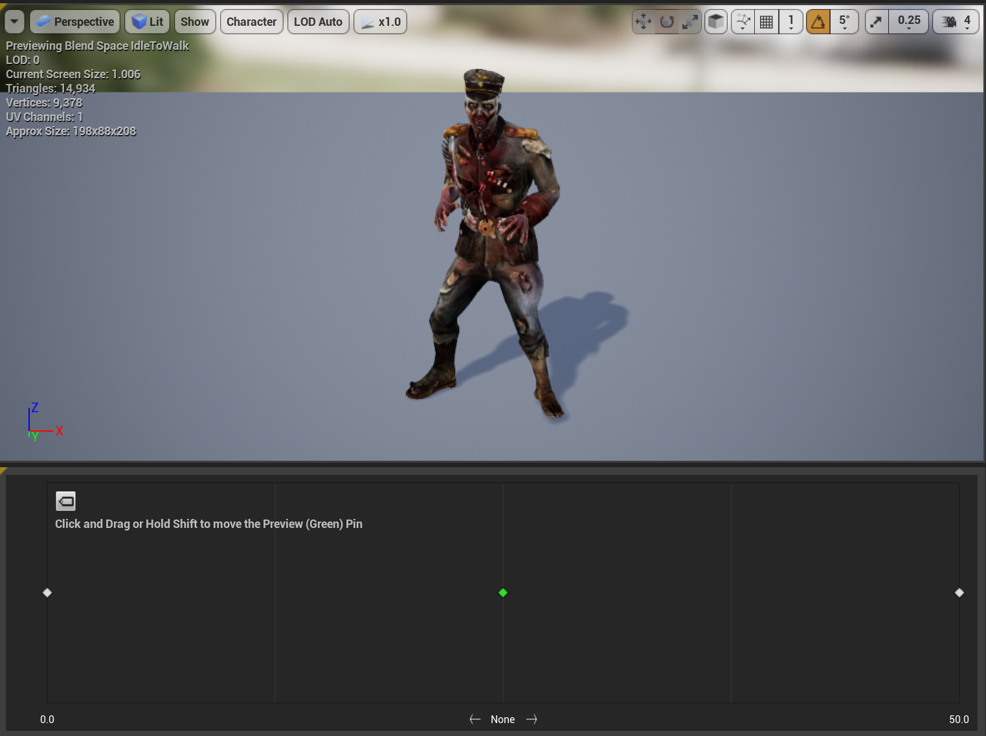
BLEND Animation Chart

Slide 10
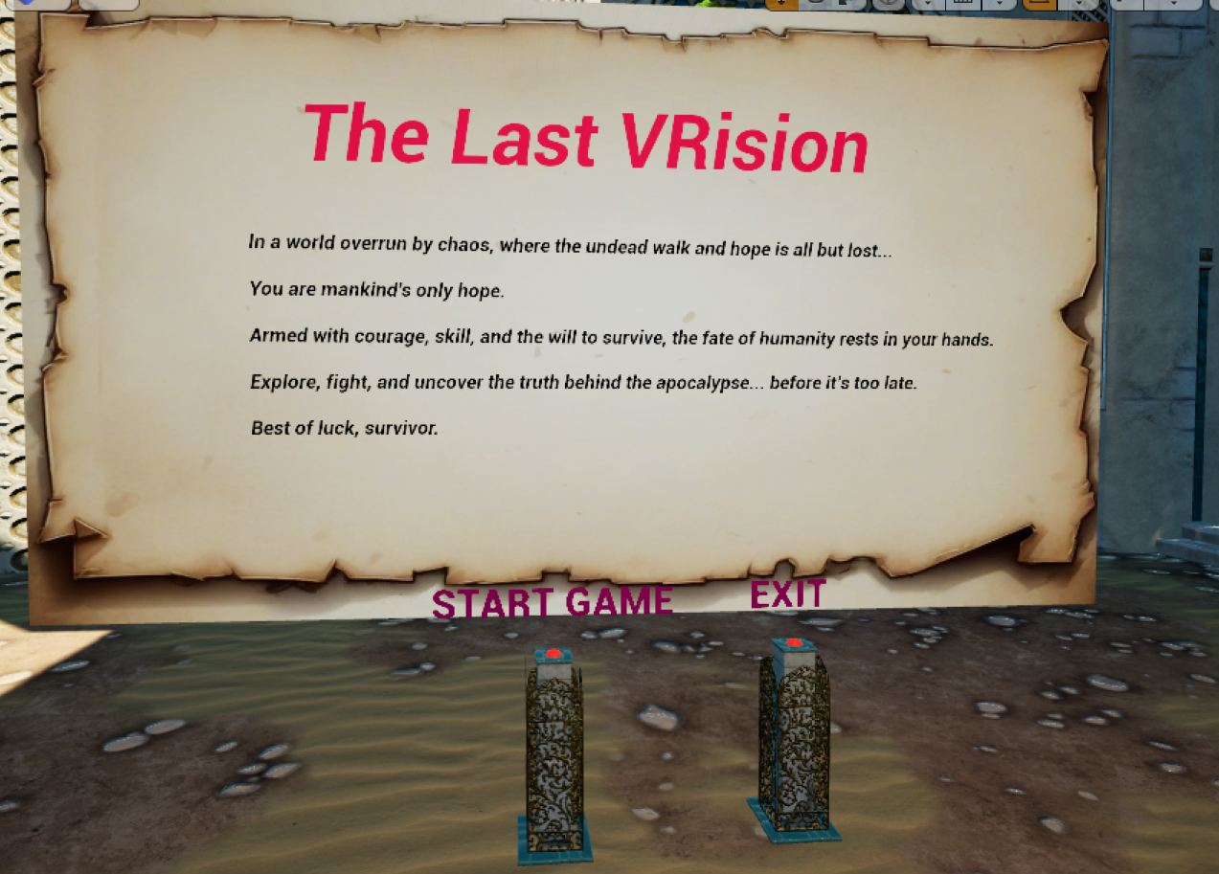
Main Menu

Slide 11
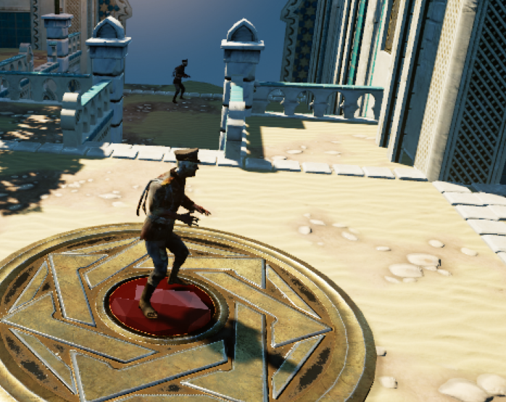
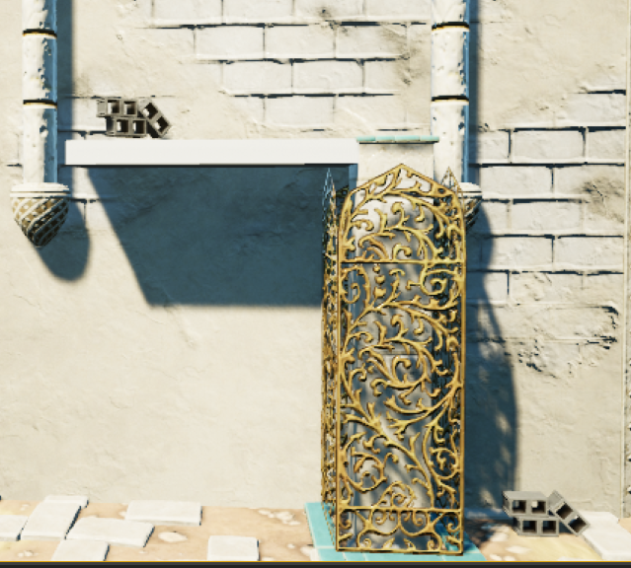
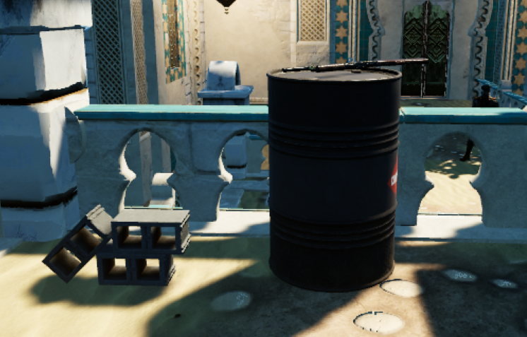
IN GAME

Slide 12
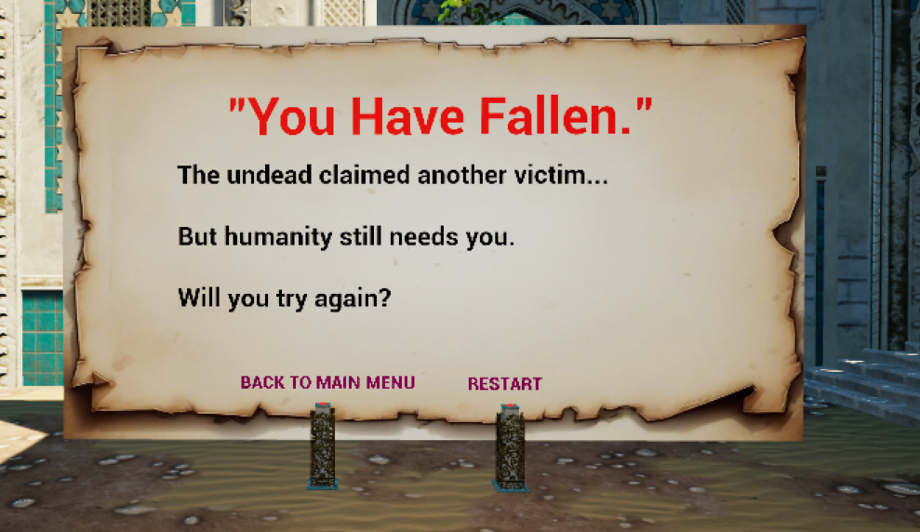
End Menu

Slide 13
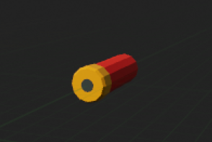
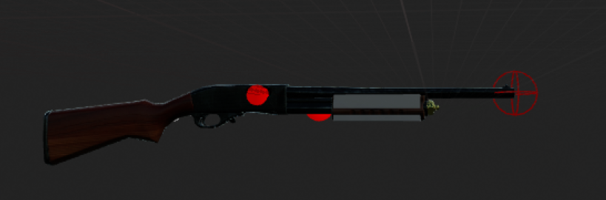
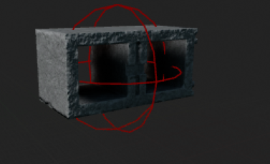
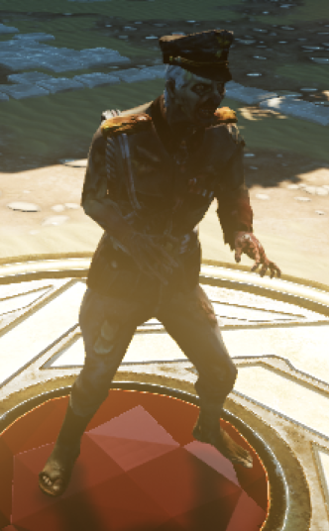
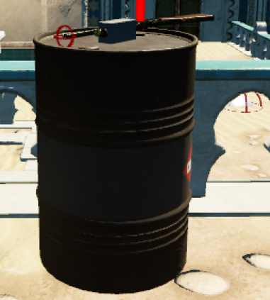
ASSET USED

Slide 14
PROBLEMS FACED
  Execution of the health mechanism in game.
  Trouble making player combat and enemies.
  Bugs caused by blueprints.
  Unreal crashing problem.
  Weapon System implementation.
  Enemy AI Implementation.
  NavMesh Implementatioon.

Slide 15


